Slide 1
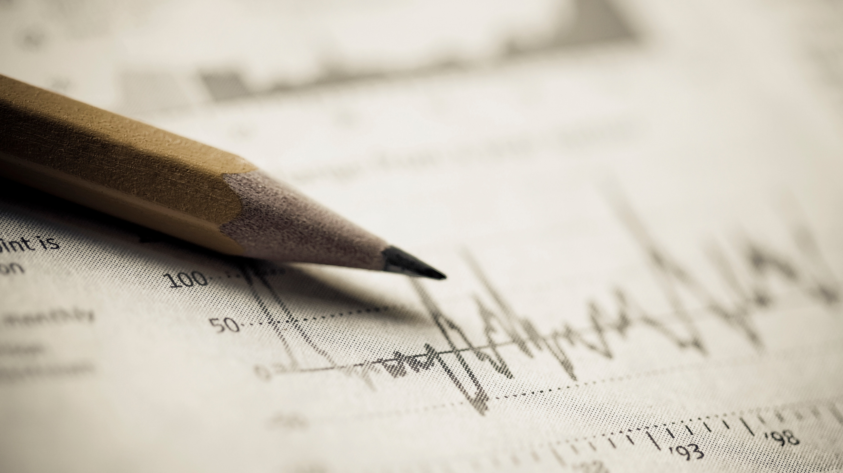
Covid-19 Tweets Data Analysis
Litao (John) Zhou

Slide 2
Topic Covered on Tweets
Heat Map visualization
Grid-Analysis in North America
Graph Visualization
Topics and Sentiment Analysis

Slide 3
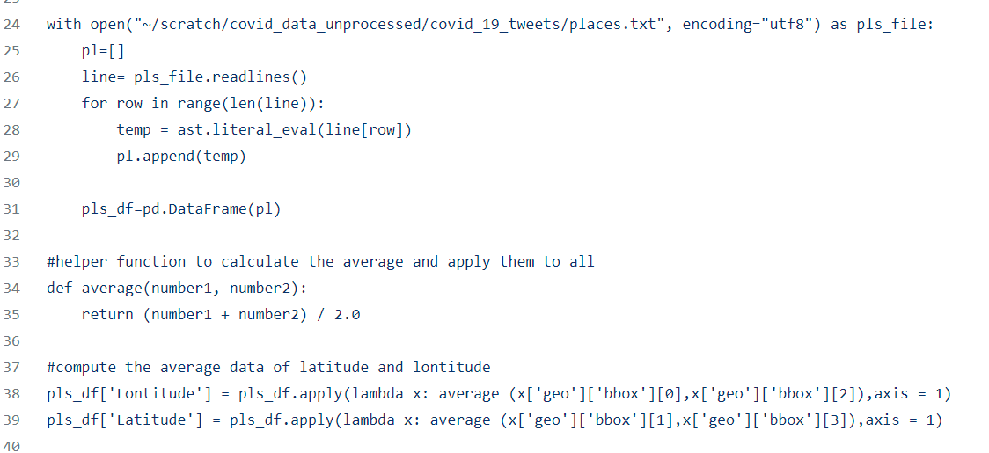
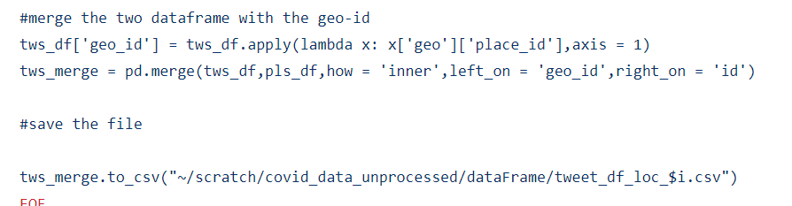
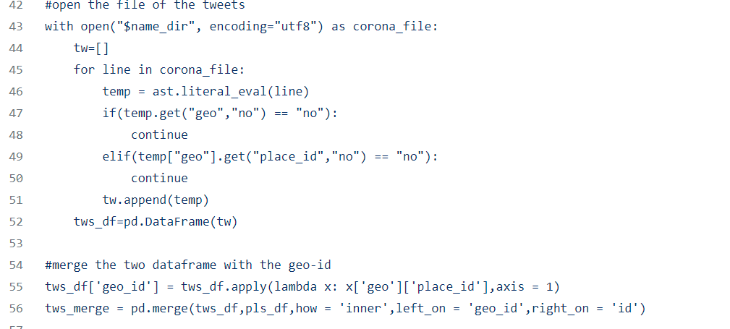
Data Cleaning ----Geo-id
Location Processing and calculate the coordinates
Merge with Geo-id and save
Tweets filtering(location)
Scripting on Compute Canada

Slide 4
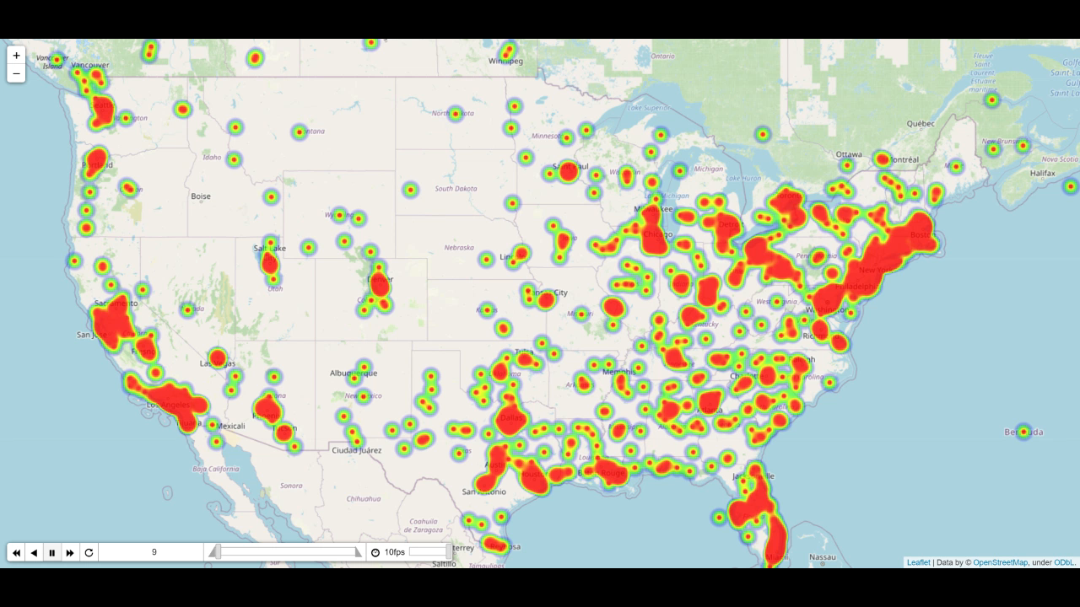
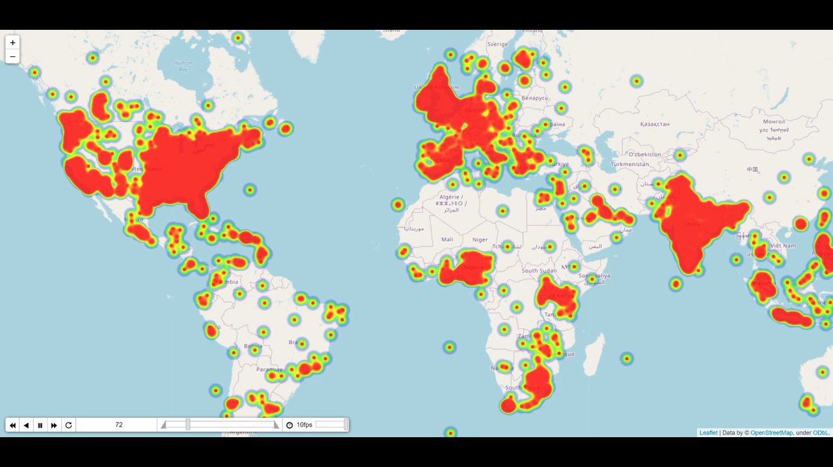
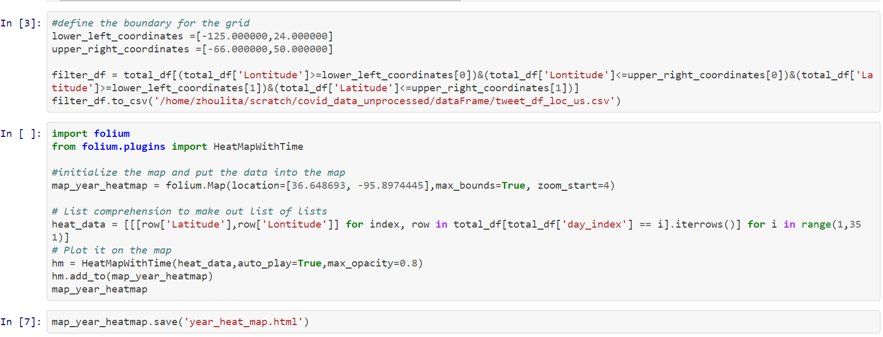
Heat Map in Time Series ----Folium Library
NO clear change in the density of the map, most tweets are in US Europe and India

Slide 5
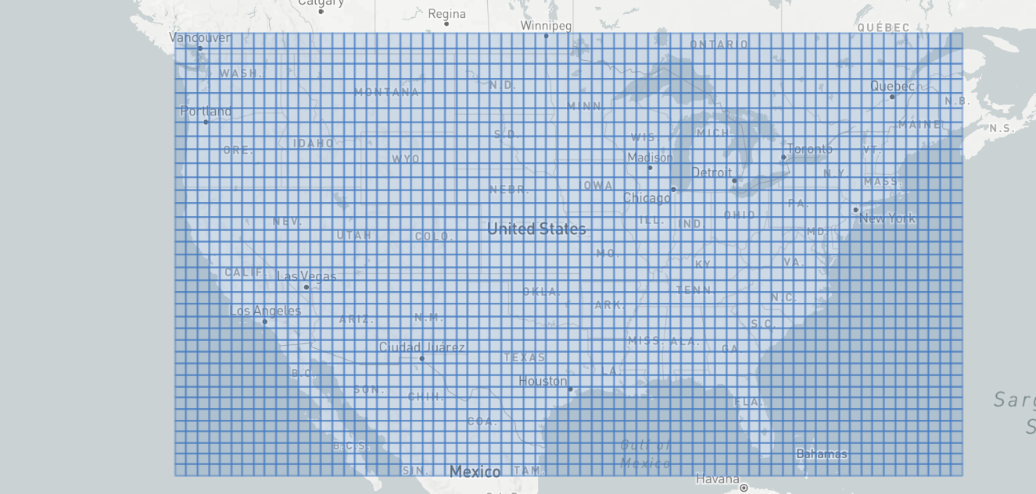
Grid Analysis in Time Series ---- GeoJson
34
identifier
‘3x4’
0
0
69

Slide 6
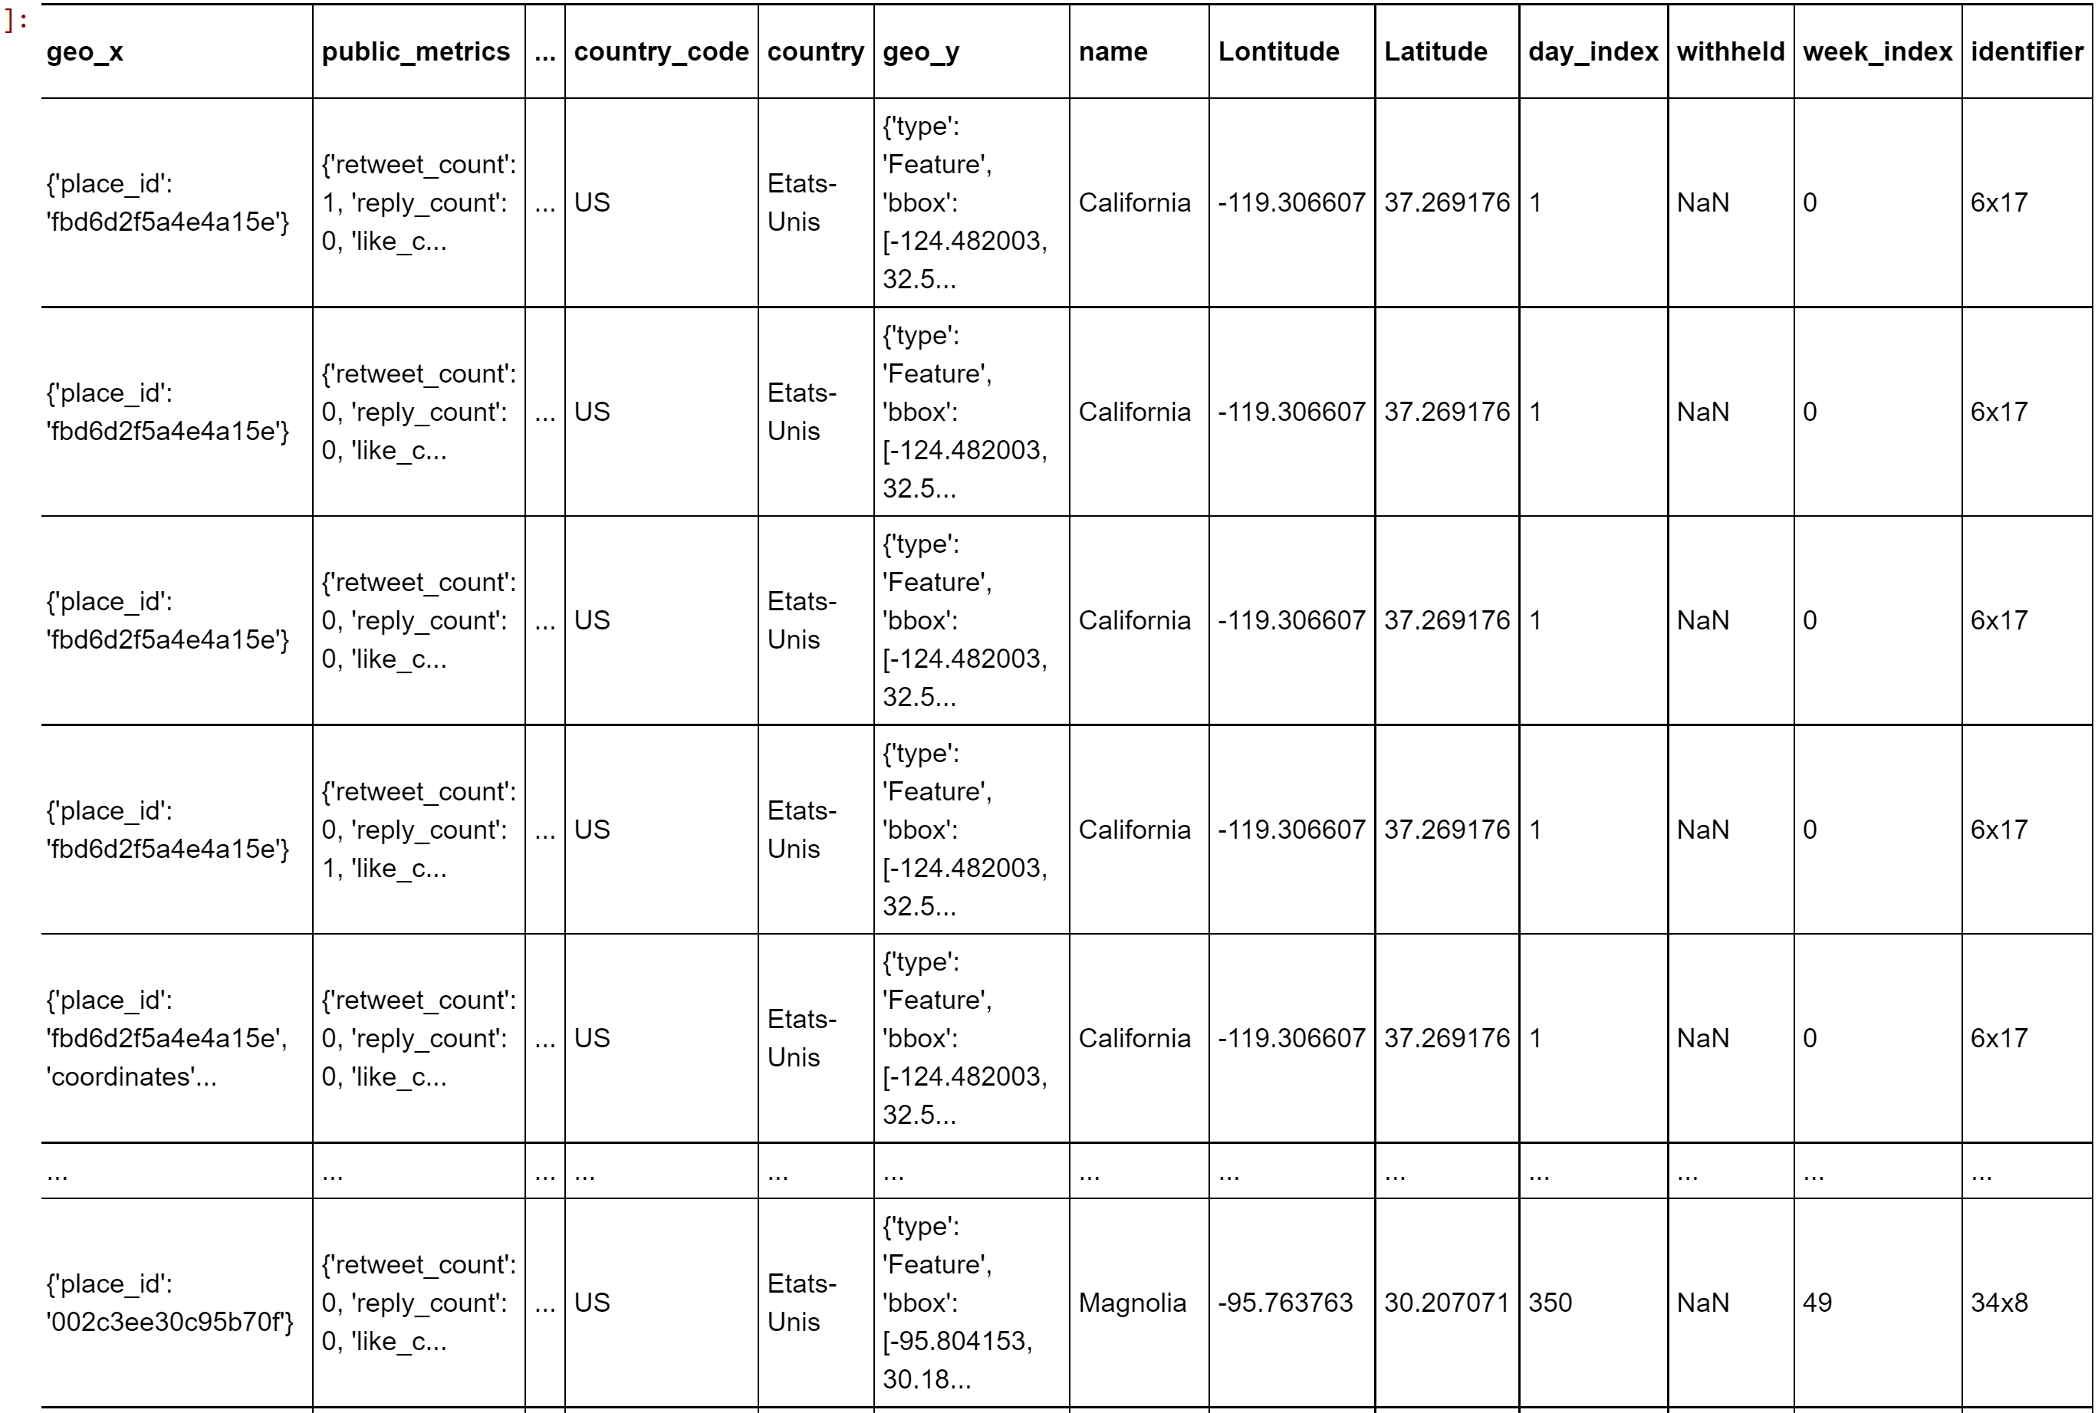
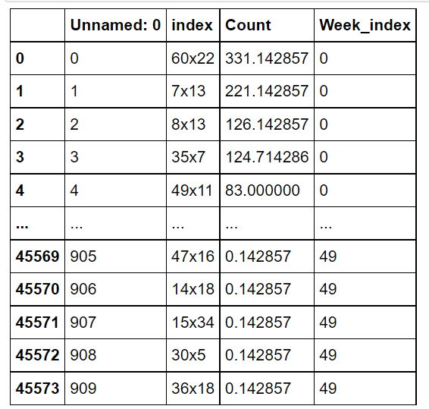
Grid Analysis in Time Series ---- Preprocess
Get the identifier and week index from the day index and the geo location and the get the average counts of tweets of the specific week in each cell(identifier)

Slide 7
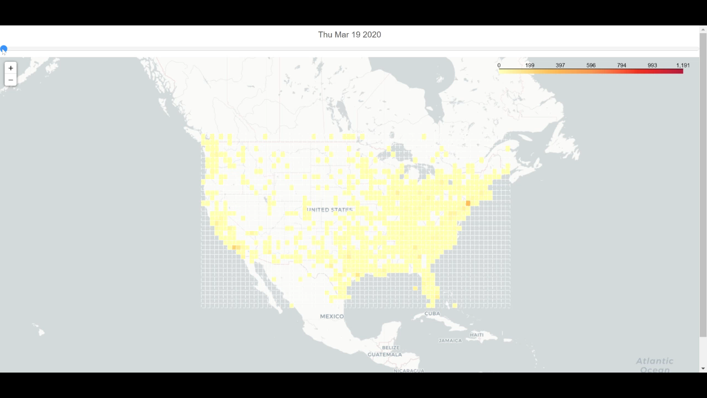
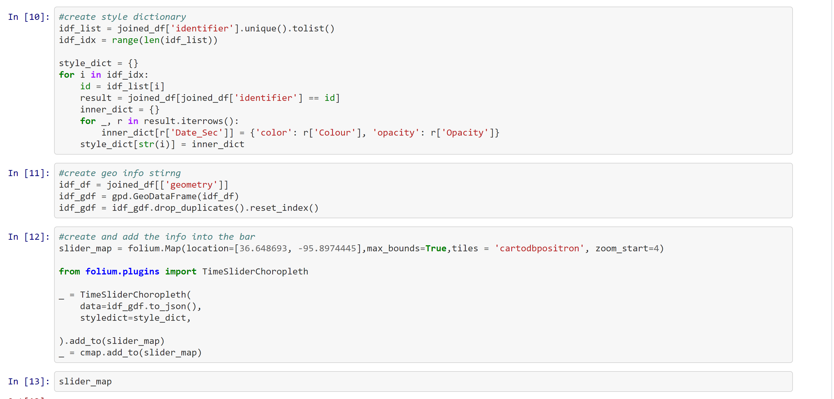
Grid Analysis in Time Series----Folium
Affects Color bar
Create the time series dictionary based on the start day of the week
Create the time series dictionary and used the folium to visualize the change in the average number of tweets in each week

Slide 8
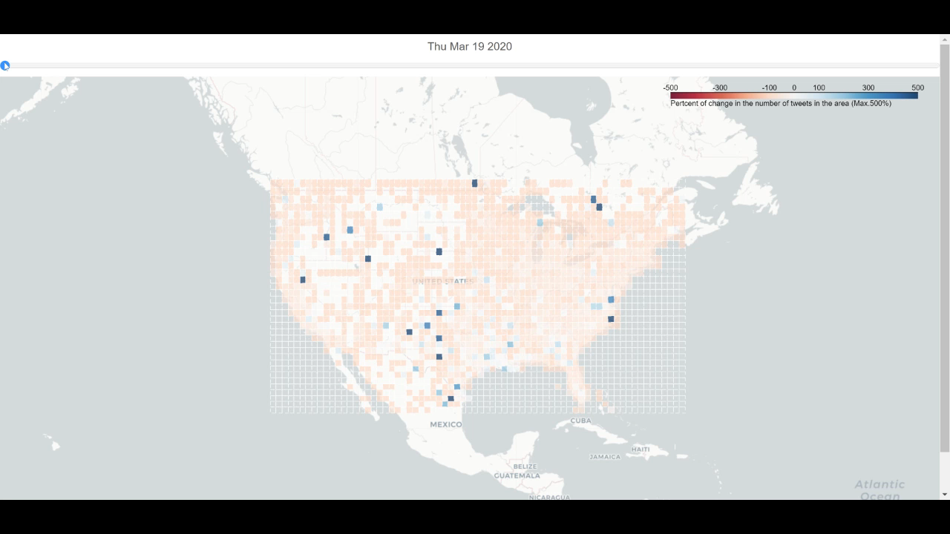
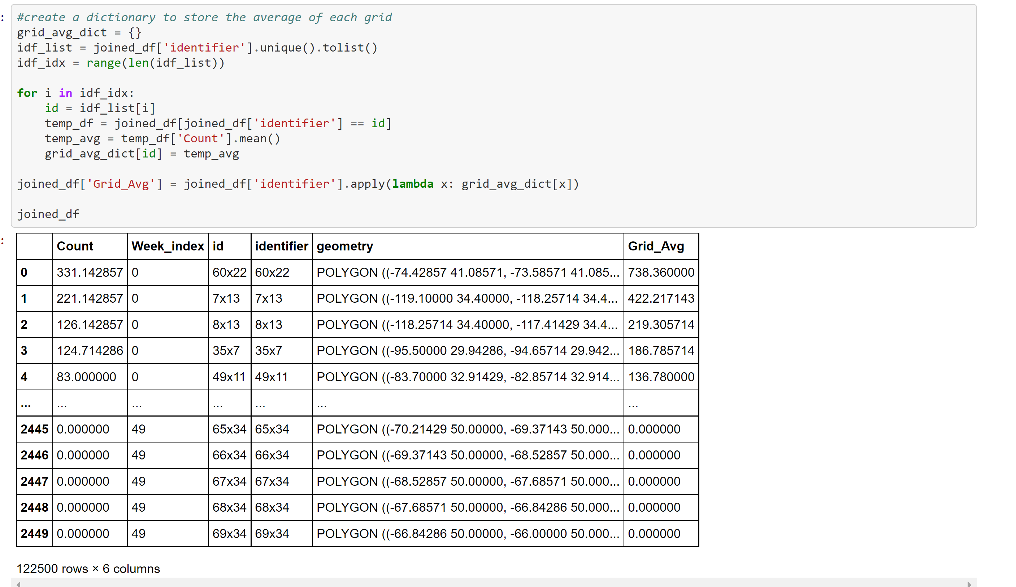
Grid Analysis in Time Series----Normalized
Create the dictionary for each cell with the key as identifier and the value is the average of the 50 weeks average number of tweets in the cell
Create the time series dictionary and used the folium to visualize the change in the average number of tweets in each week, filtered out the noise with maximum change to be 150%

Slide 9
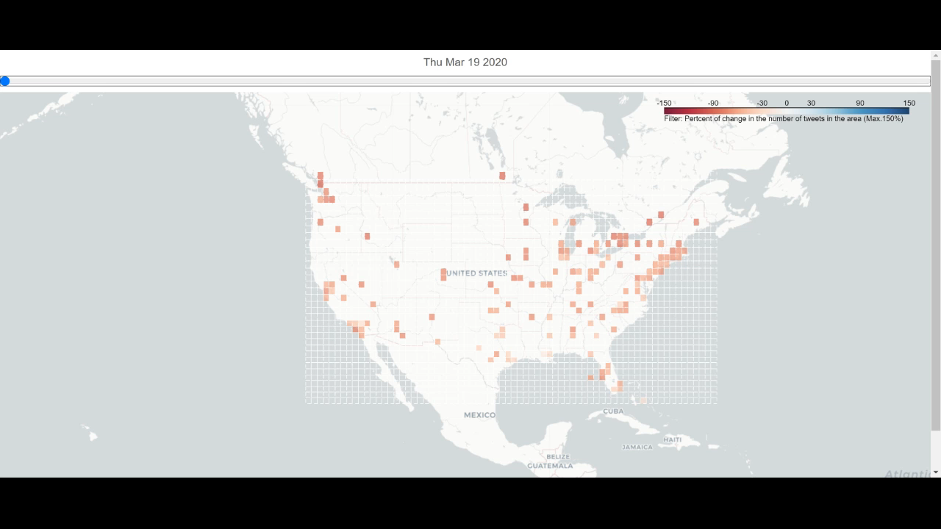
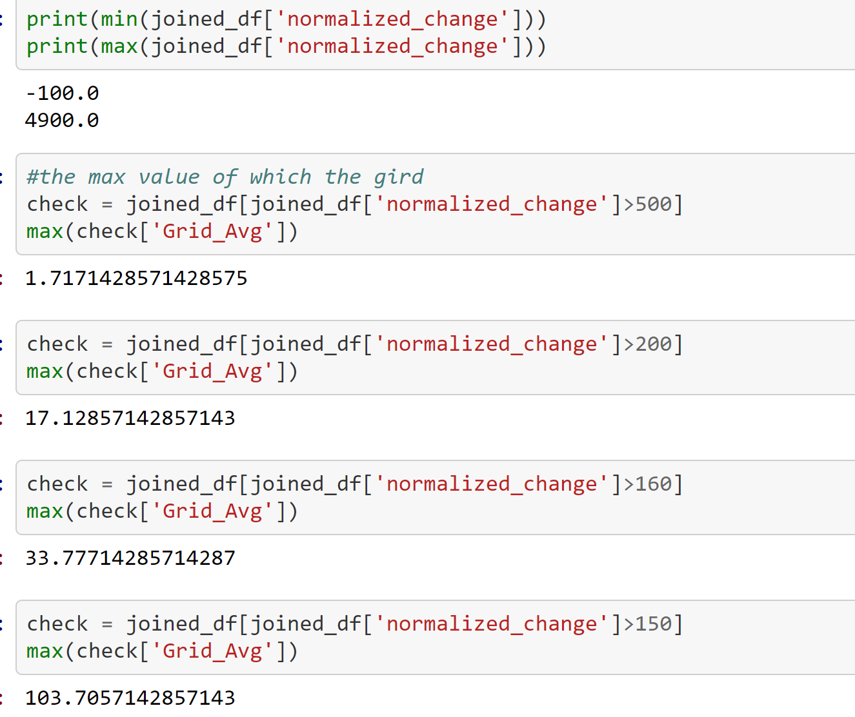
Grid Analysis in Time Series----Filtered
Remove the cell with large change percentage
Cell with large change value are those with small average
Remove the noise(the small value)

Slide 10
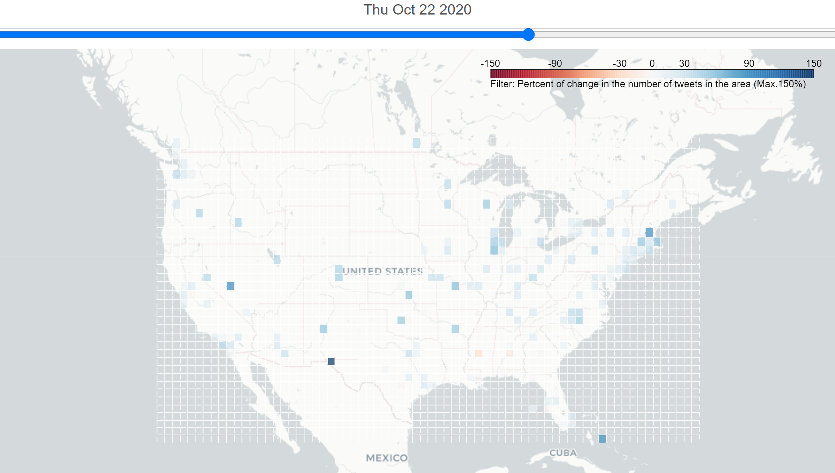
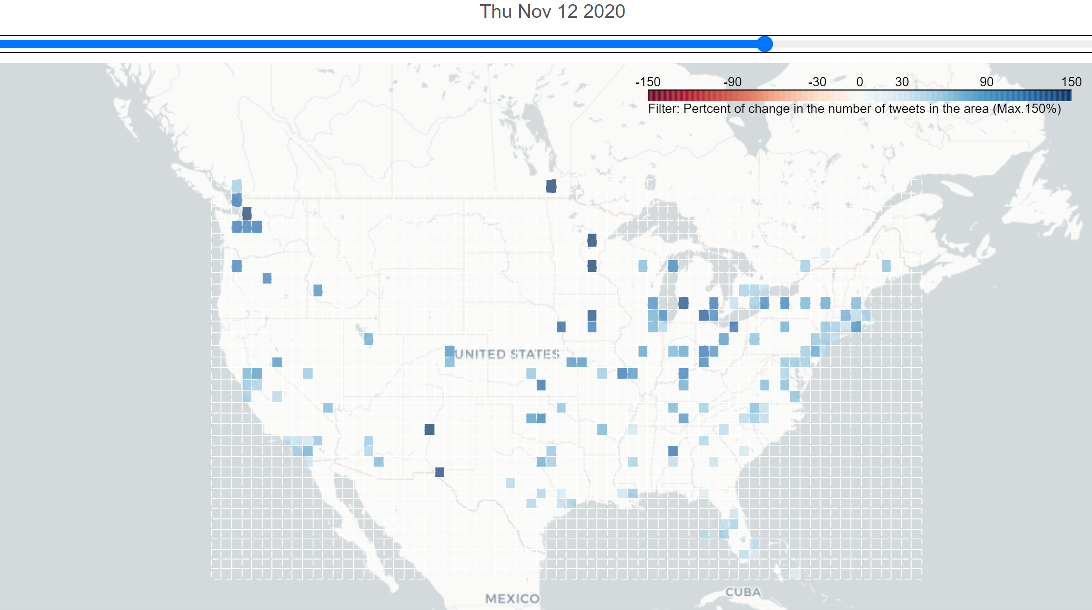
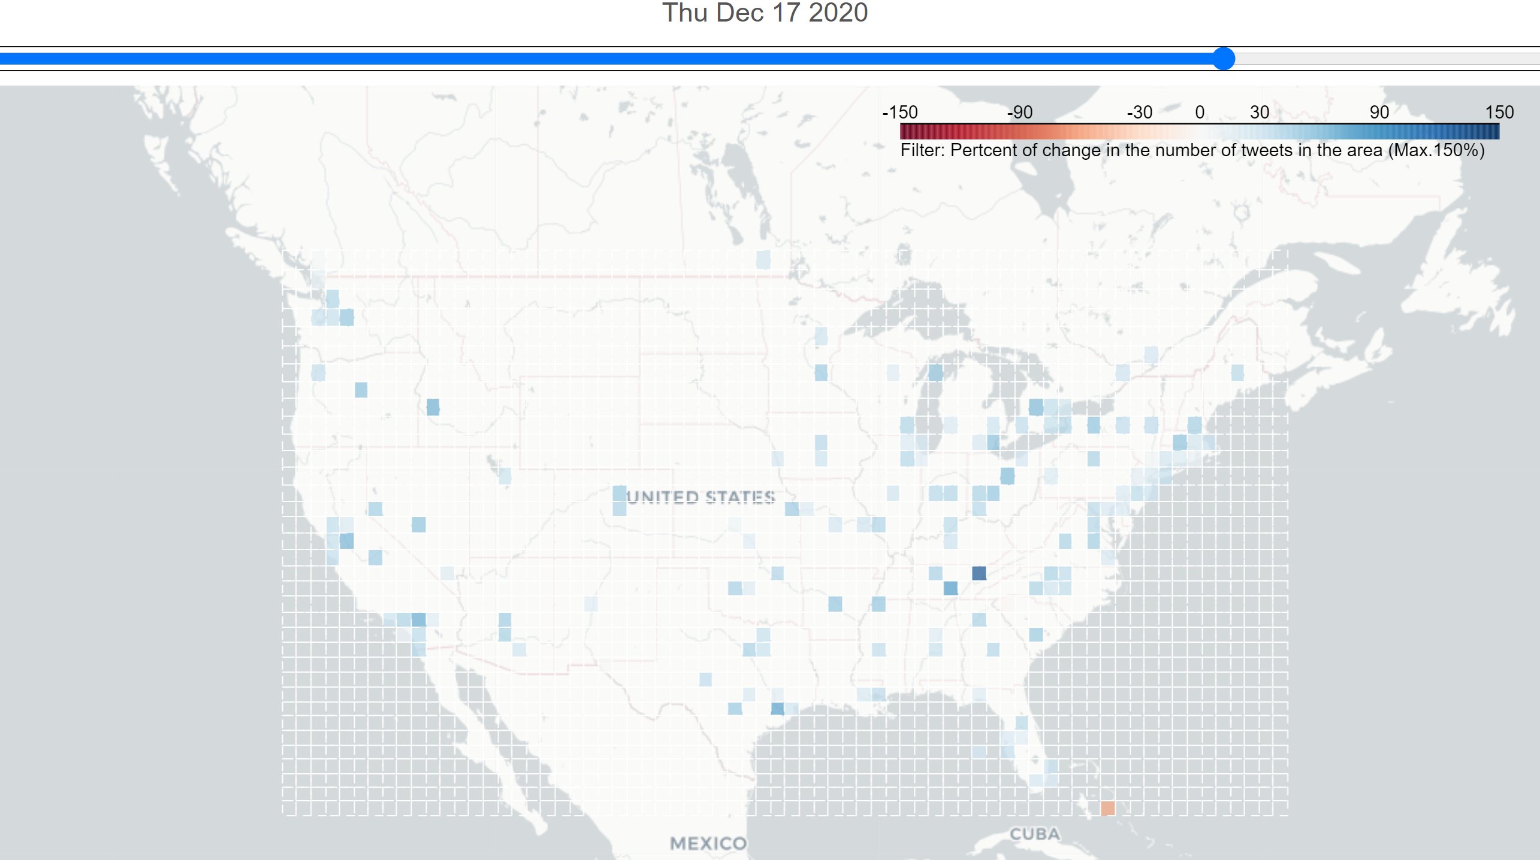
Grid Analysis in Time Series----Filtered
US election has a great influence on the analysis

Slide 11
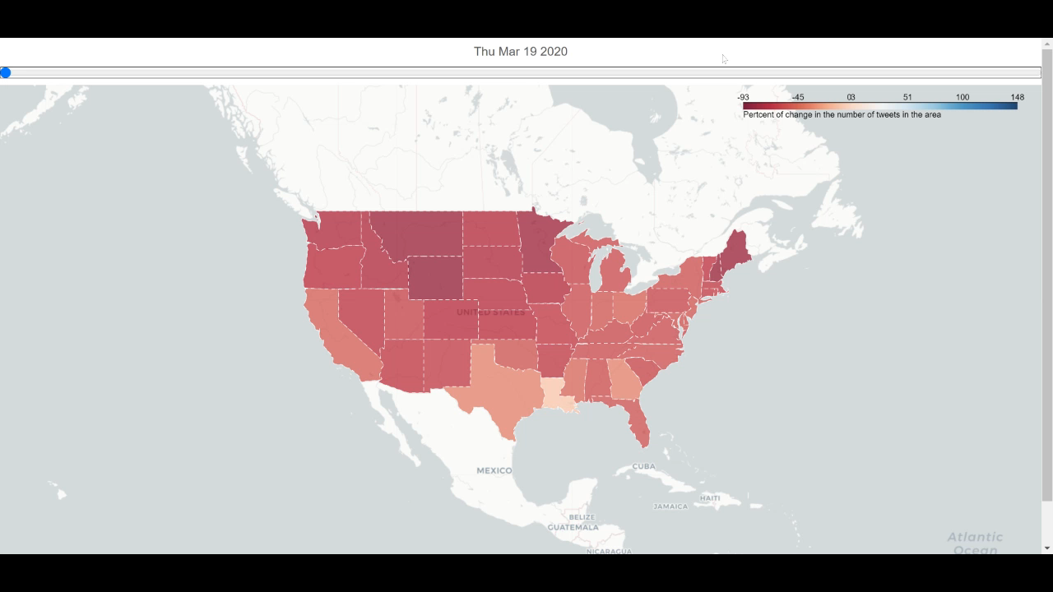
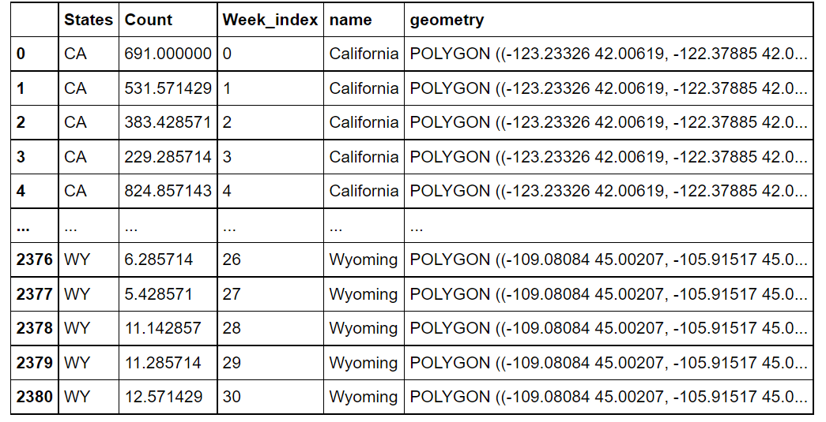
State Analysis in Time Series
Conduct Similar analysis on the state level instead of the grid and would only conduct the analysis for 30 weeks(before the middle of October)

Slide 12
The relationship between the number of tweets and confirmed case/death cases?

Slide 13
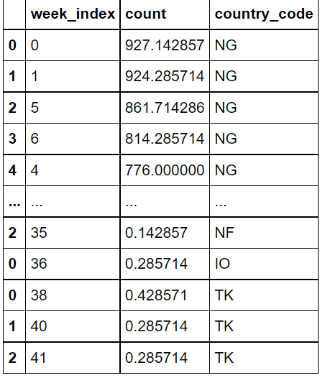
Nation level ---- scatter plot of 8 countries
Aimed for the correaltion between the average tweets number and the confirmed cases/ death cases

Slide 14
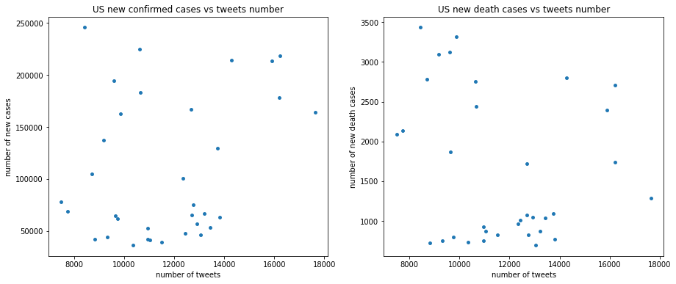
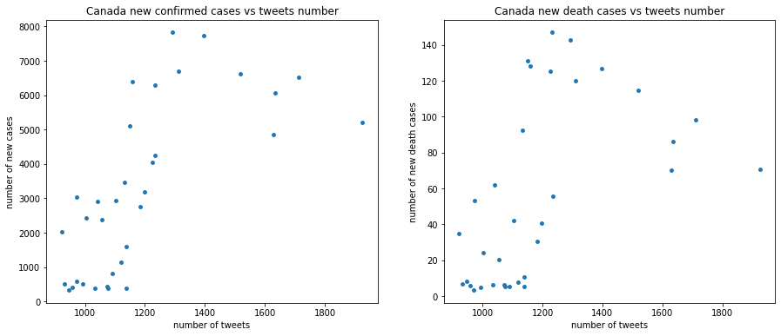
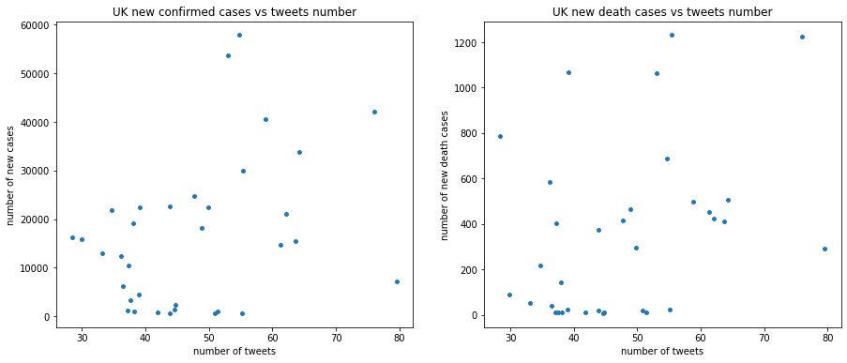
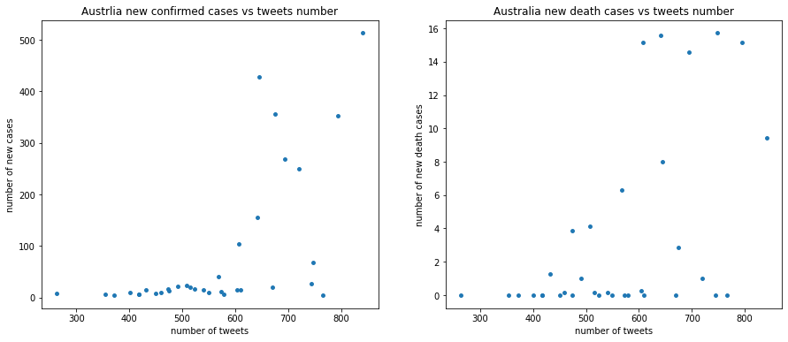

Slide 15
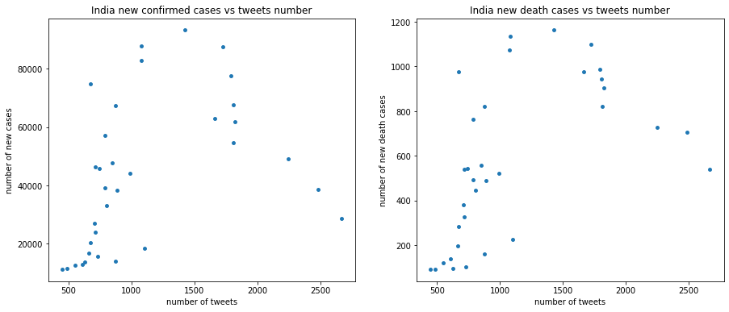
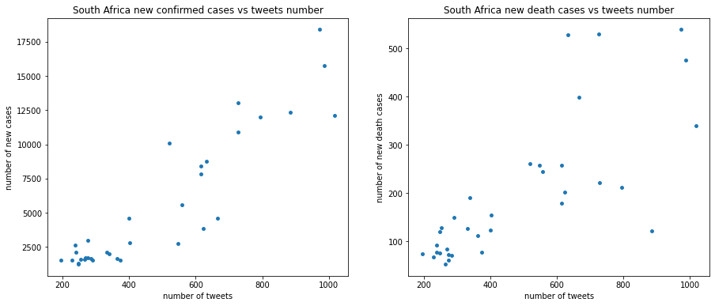
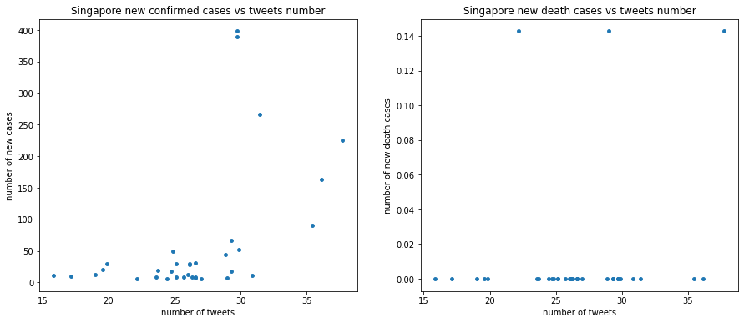
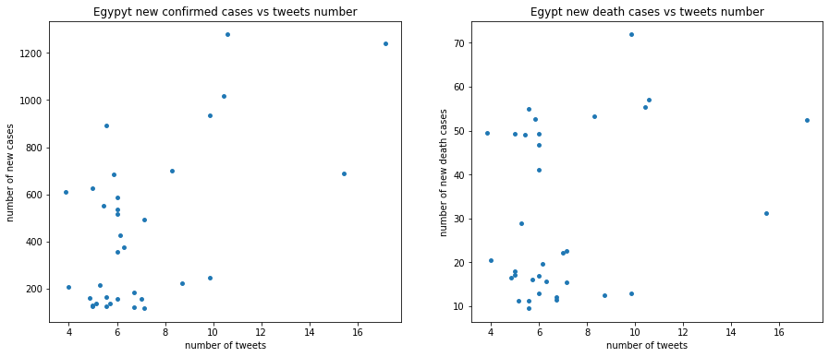

Slide 16
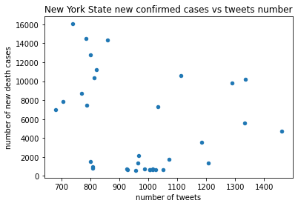
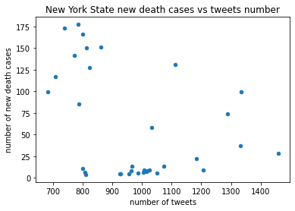
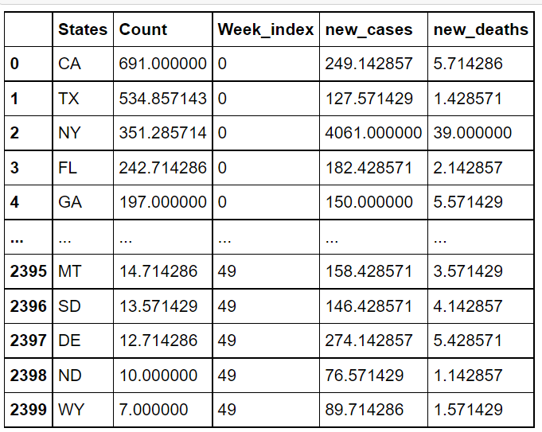
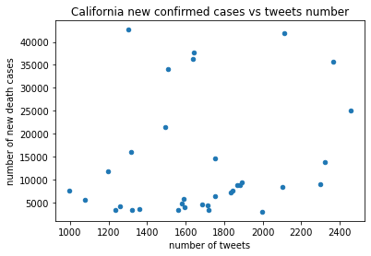
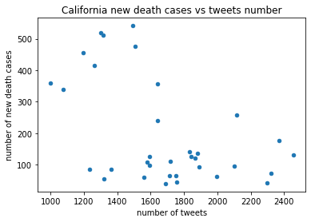
States’ level ---- scatter plot of 3 states

Slide 17
Take a look at the contents!

Slide 18
Family related tweets with emotion polarities
Regex
Election-related key words: Trump|Biden|Election|democratic|republican|party|President|campaign|elector|candidate(X)
Family-related key words: sister|brother|mother|father|grandpa|grandma|grandparents|grandmother|grandfather|cousin|child|dad|mom|uncle|aunt|nephew|niece|son|daughter|relative|cousin|parents|husband|wife|family
Covid19-related keywords: corona|covid|virus|pandemic|epidemic|quarantine|lockdown|social distancing|isolation|mask|infectious|formite|vanccine|vaccination
Textblob(vader) : NLTK for text polarties
Clean the texts and filter the related tweets with topic words

Slide 19
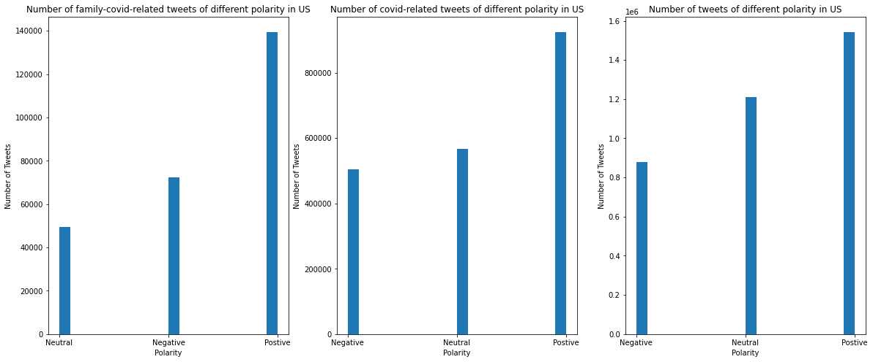
Family related tweets with attitudes
The number of tweets have shown higher number of positive tweets

Slide 20
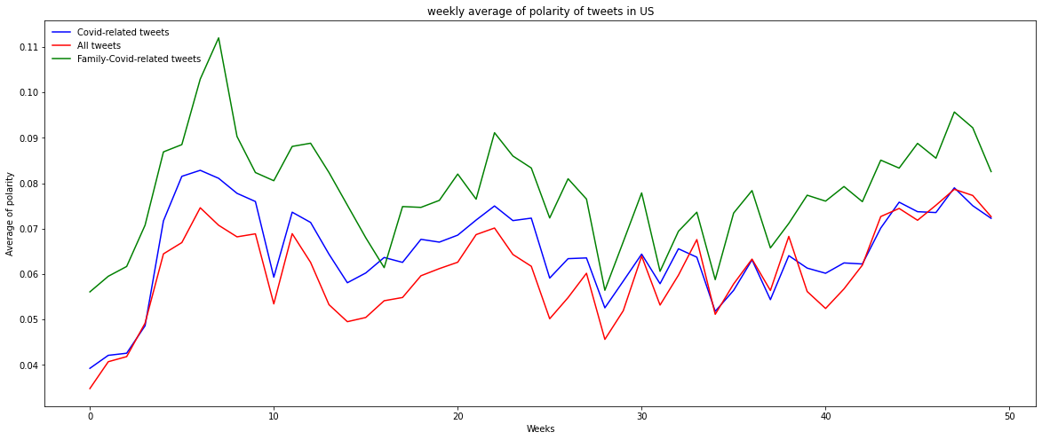
The number of covid-related tweets varies in weekly basis

Slide 21
Latent Dirichlet Allocation (LDA) on family-covid-related tweets
Data cleaning
Build the bigram and trigram models
Remove Stopwords, Form Bigrams, Trigrams and Lemmatization for phrase listTextblob(vader) : NLTK for text polarities
Set up the model and set different number of topics and find the best model with coherence number
Model Visualization and show in word cloud
identifying topics in those tweets that contains the family and covid19 as topic words

Slide 22
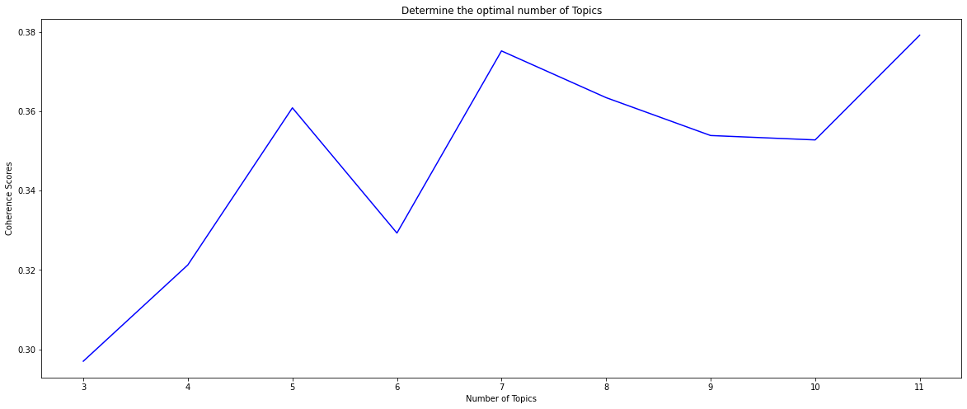
Get the best topic number with coherence number
Best topic number is set to be 7

Slide 23
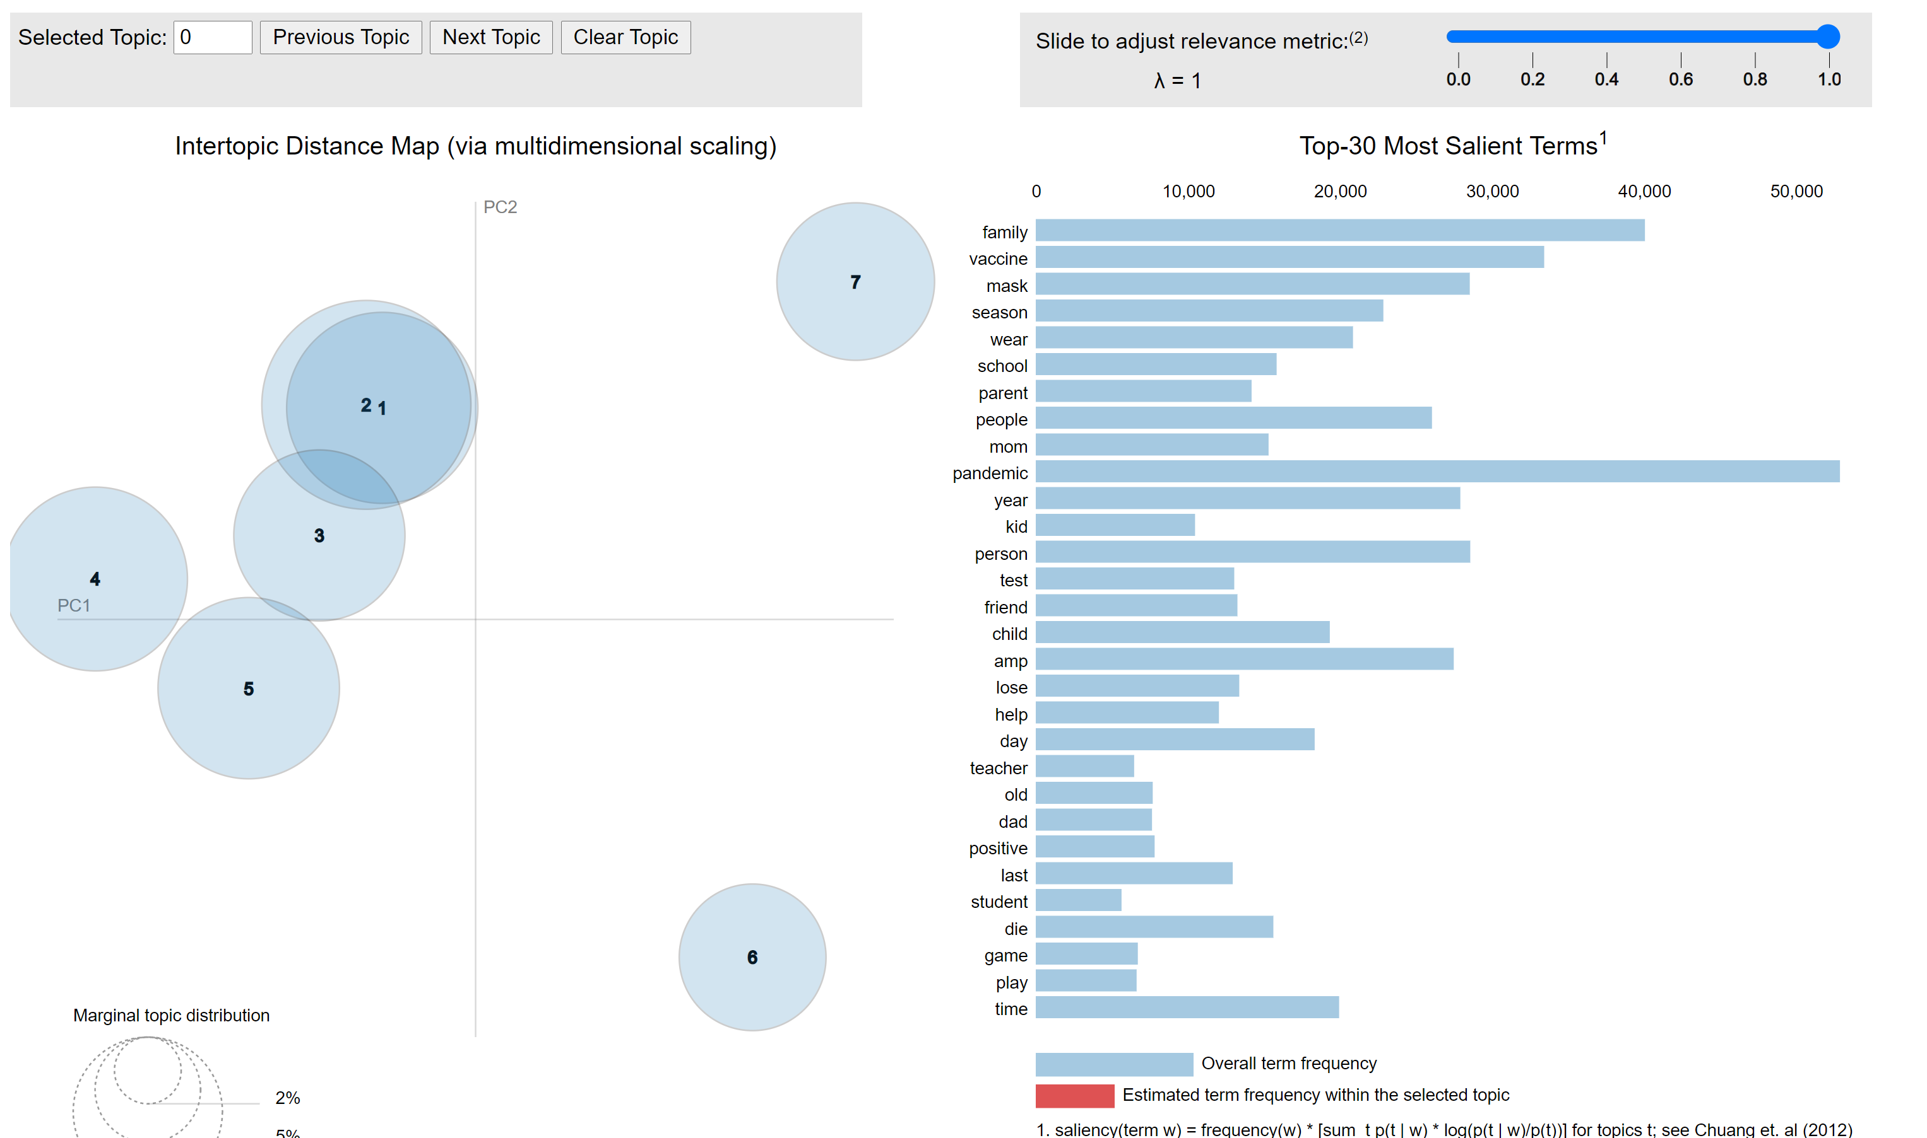

Slide 24
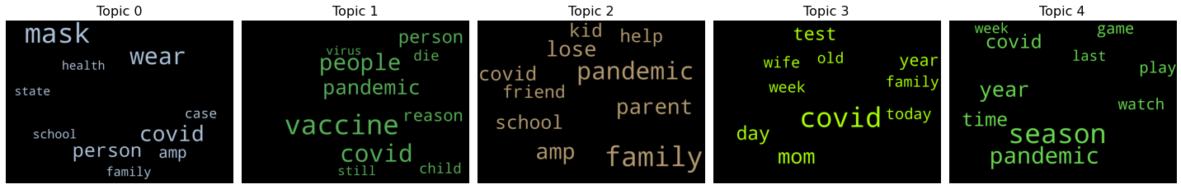
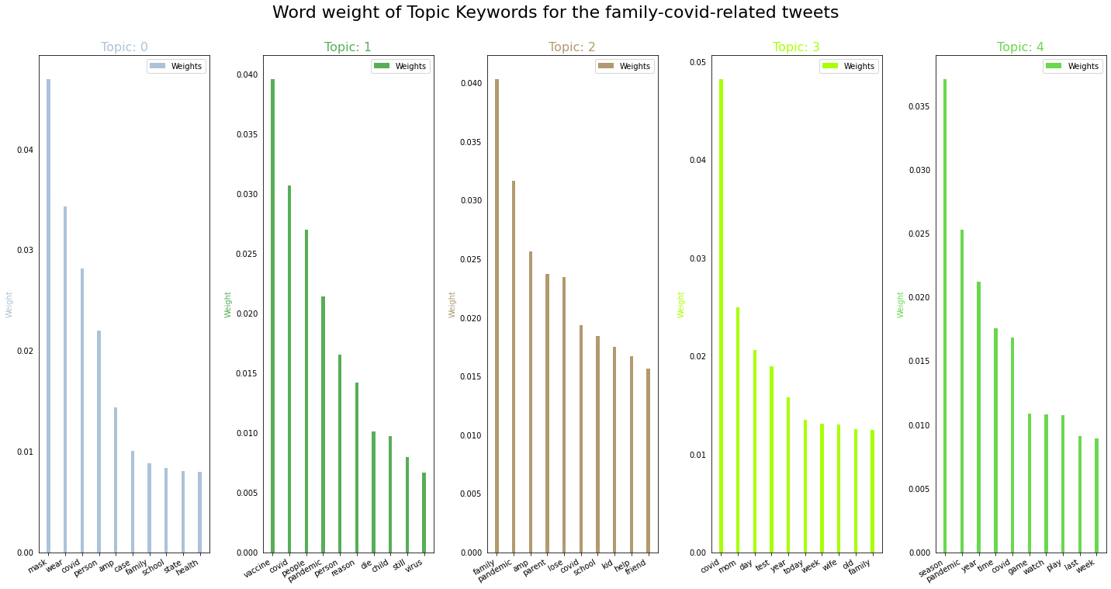
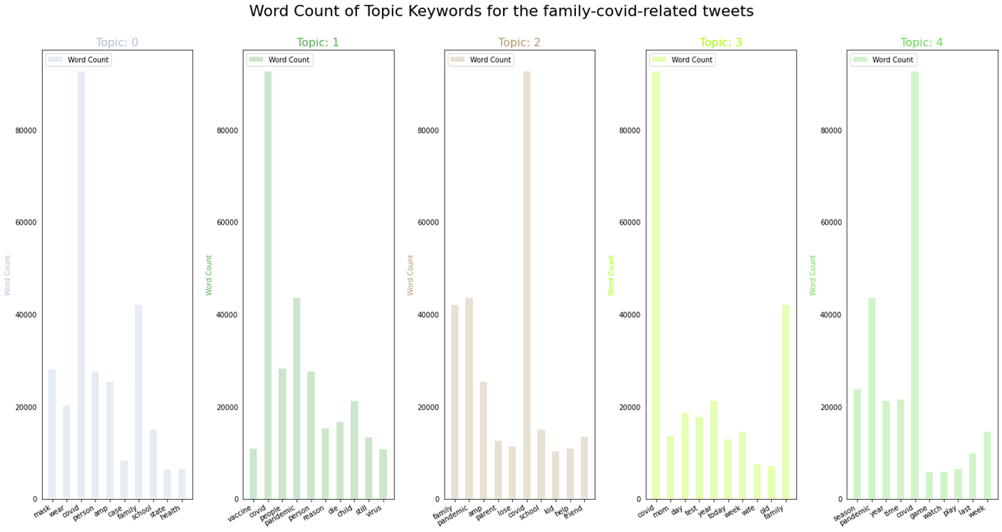

Slide 25
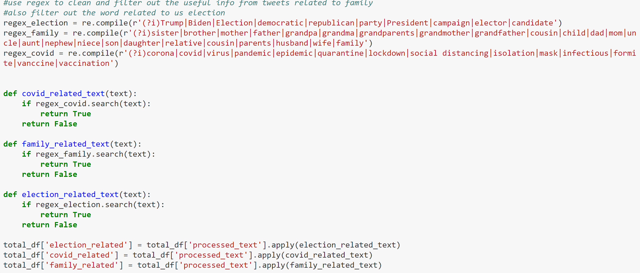
Mask attitudes analysis
Regex
Election-related key words: Trump|Biden|Election|democratic|republican|party|President|campaign|elector|candidate(X)
Mask|mask
Vader as Sentiment Intensity Analyzer
Line graph of the log-ratio of pro-mask over anti-mask in time series
Pro mask or anti-mask?

Slide 26
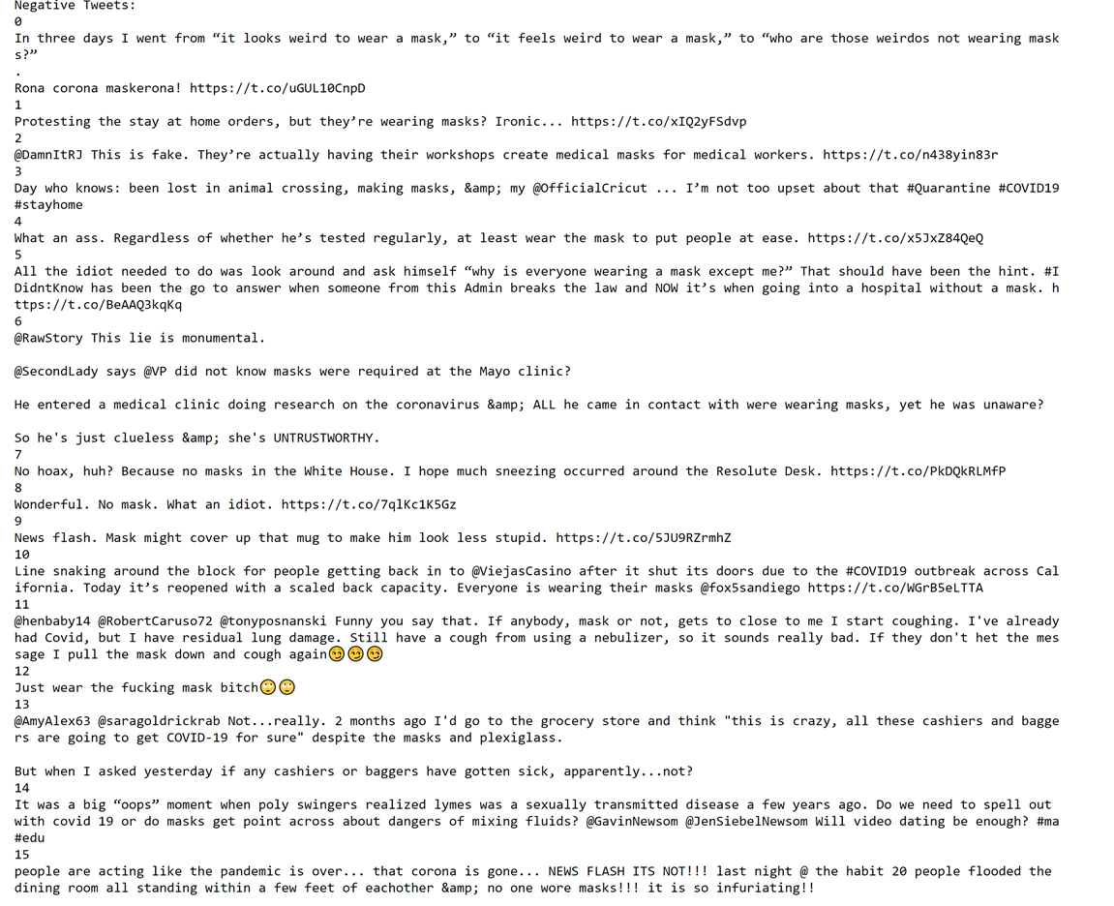
Issue of sentiment analyzer
Would only look at the polarity of the sentence instead of the content itself

Slide 27
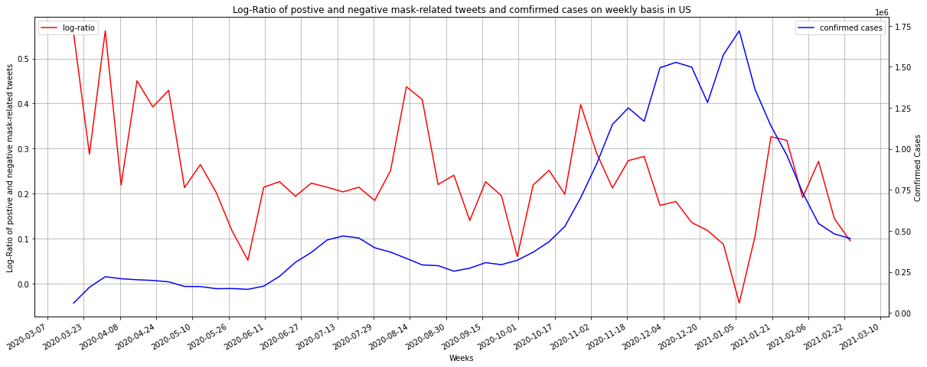
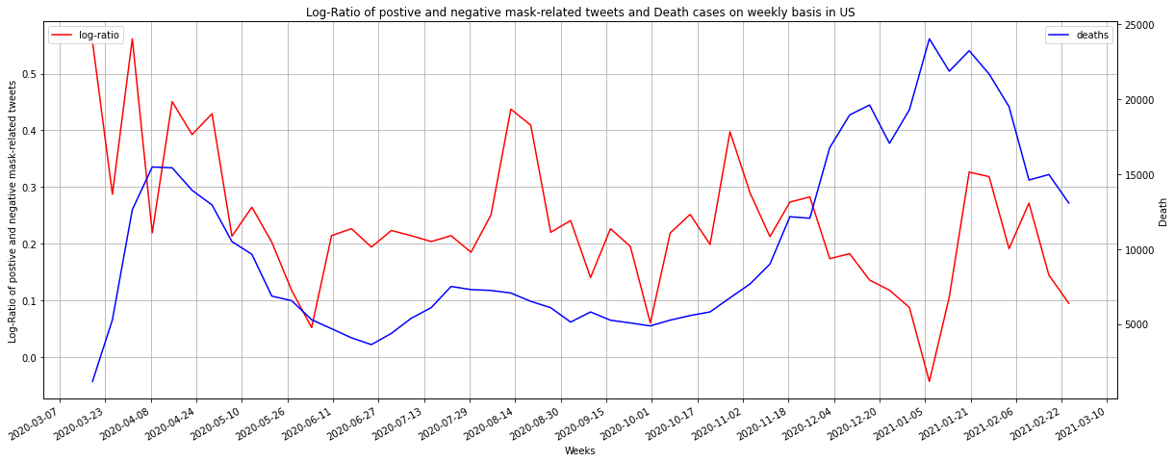
Line Graph of the log-ratio and the confirmed (death) cases in US
Expect to see the lagging

Slide 28
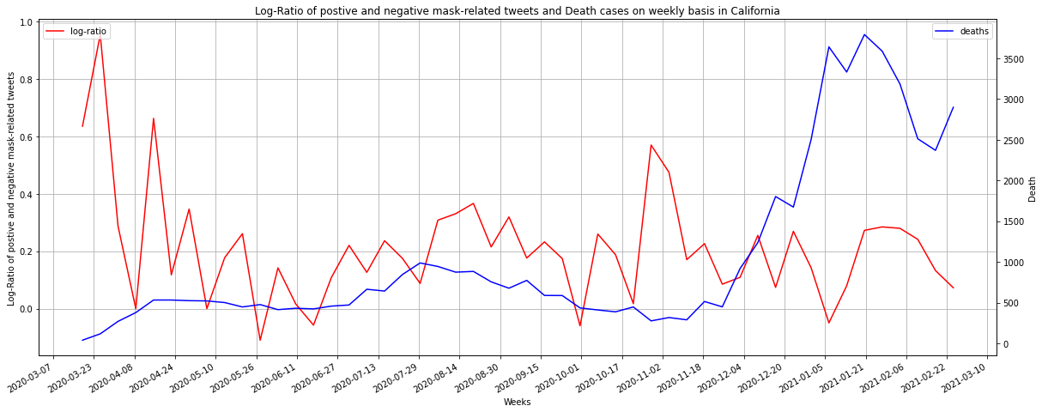
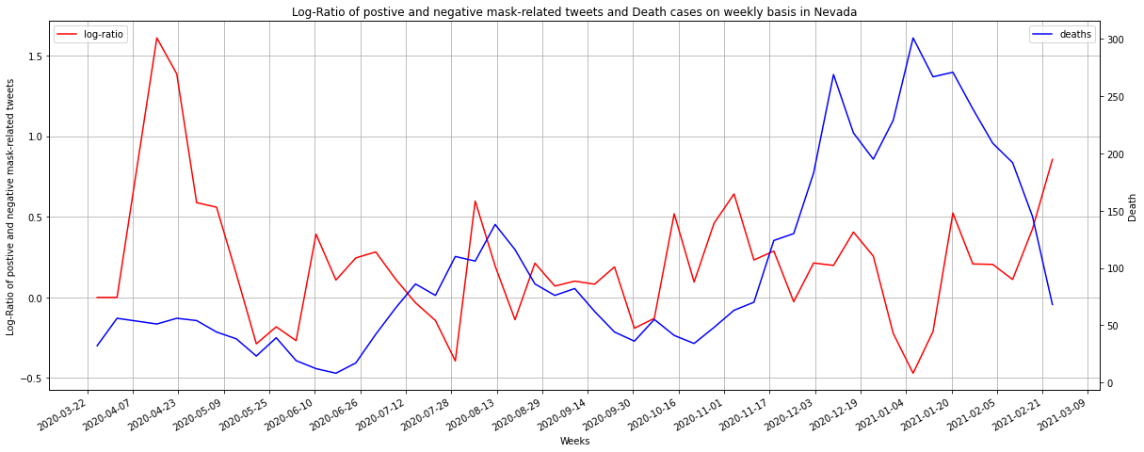

Slide 29
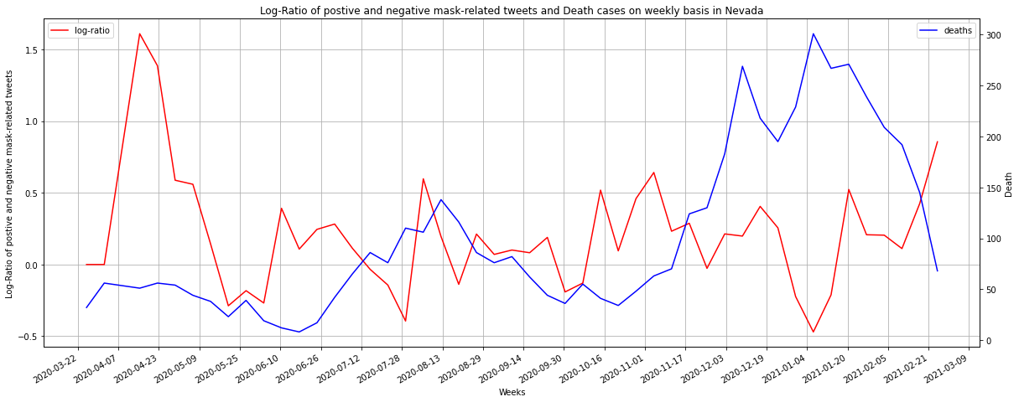

Slide 30
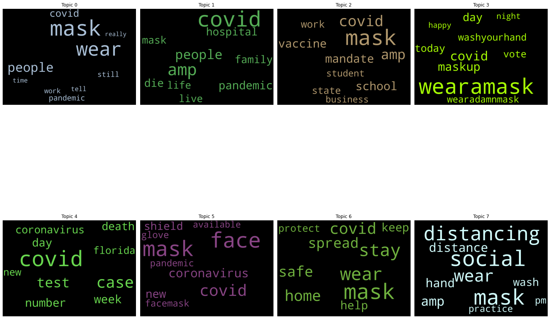


LDA model on masks
Use similar technique for the tweets that contains the topic word mask

Slide 31
Thank you!
Litao(JOHN) zHOU

